Slide 1

Optimizing Inventory with Data Forecasting Analysis

Slide 2

Agenda
Objective: To identify the most accurate forecasting model for NovaTech's sales data.
Methodology: Comparison of five forecasting models using one year sales data.
Focus: Analyzing data at two different intervals (Daily vs Monthly) to see which model fits best.

Slide 3

About NovaTech Store
NovaTech Store is a reputable retailer specializing in Lenovo Pcs (high-performance workstations and laptops).

Slide 4
Goal
Explore various forecasting techniques and provide the management with the best recommendation.

Slide 5



Which models did we Test?
Naïve Forecast: Assumes the next period is equal to the last.
Moving Average: smooths recent data, 2 days for daily and 2 months for monthly.
Exponential Smoothing
Linear Forecast (Trend): identifies long term direction.
SLR with Seasonality: Accounts for repeating patterns.

Slide 6

Key Findings

Slide 7
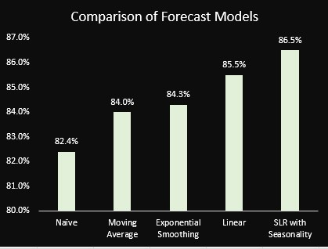
Daily Sales: SLR with Seasonality
Naïve: 82.5%
Moving average: 84%
Exponential: 84.3%
Linear: 85.5%
SLR with seasonality: 86.2% (Best)

Slide 8
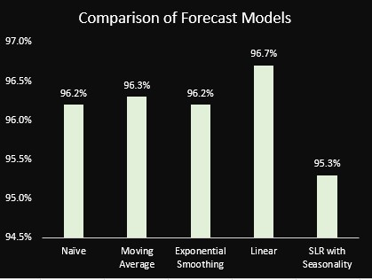
Monthly Sales: Linear (Trend)
Naïve: 96.2%
Moving average: 96.3%
Exponential: 96.2%
Linear: 96.7% (Best)
SLR with seasonality: 95.3%

Slide 9


Why the Difference?
Monthly:
The patterns show growth or decline
It removes the daily ups and downs
Best Model: Linear Forecast
Daily:
The patterns repeat weekly
It shows every ups and downs
Best Model: SLR (Seasonality)

Slide 10
Daily Forecasting Models Comparison
Models | MAE | MSE | MAPE | ACCURACY
Naïve | 7.27 | 84.22 | 17.15% | 82.5%
Moving Avg (2 days) | 6.55 | 66.46 | 16% | 84%
Exponential Smoothing | 6.49 | 3.25 | 15.7% | 84.3%
Linear Forecast (Trend) | 6.31 | 65.91 | 14.5% | 85.5%
SLR with Seasonality | 5.63 | 50.41 | 13.8% | 86.2%

Slide 11
Monthly Forecasting Models Comparison
Models | MAE | MSE | MAPE | ACCURACY
Naïve | 49.18 | 3355.73 | 3.8% | 96.2%
Moving Avg (2 months) | 49.95 | 3951.23 | 3.7% | 96.3%
Exponential Smoothing | 49.66 | 3639.83 | 3.8% | 96.2%
Linear Forecast (Trend) | 42.43 | 2637.60 | 3.3% | 96.7%
SLR with Seasonality | 60.22 | 4786.22 | 4.7% | 95.3%

Slide 12
Recommendation
Monthly Planning
Model: Linear Forecast (Trend)
It shows the growth or decline over time.
Daily or weekly Planning
Model: Simple Linear Regression with Seasonality.
It predicts short-term ups and downs based on pattern repetition.

Slide 13

Thank you
Martha Maxwell
marthamaxwell02@gmail.com

